Slide 1
Big Data Project
Learning from the Dead
CDC Dataset on Death in the US
BUDT758B
0501 Group 2
Aditya Damle
Sarika Dhoot
Yutong Chen
Aditya Safi
Aasish Sipani
Bo Tang

Slide 2

Contents
1 Question Proposing
2 Data Processing
3 Results & Visualization
4 Highlights & Policy Suggestions

Slide 3
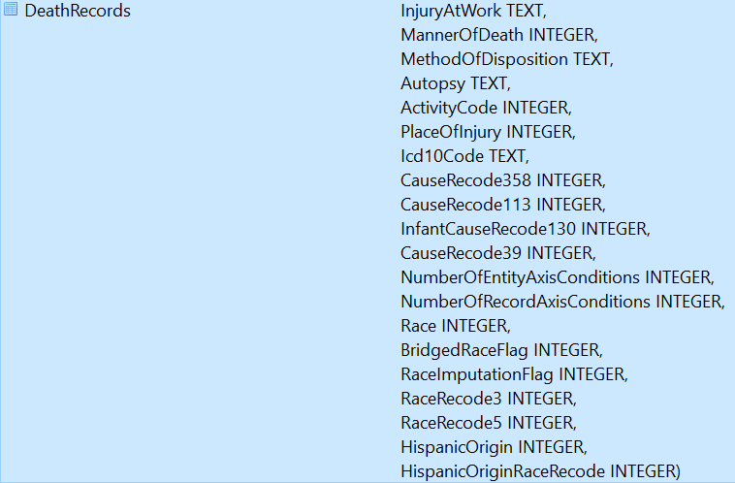
1
Question Proposing
Death record of all people who died in the US in 2014
What we have: causes of death and the demographic background (age, gender, race, marital status, place of injury, etc.)
What we want: use this data set to address important policy-related questions

Slide 4

2
Data Processing
Preliminary work：
Remove redundant columns that have less significance.
Unify metrics measurement.
Remove records that contain unknown data.

Slide 5
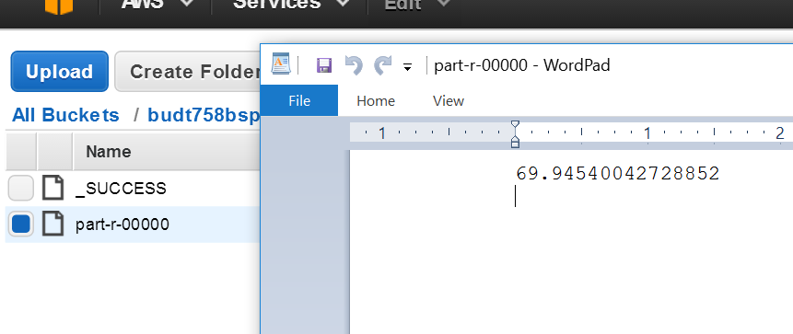
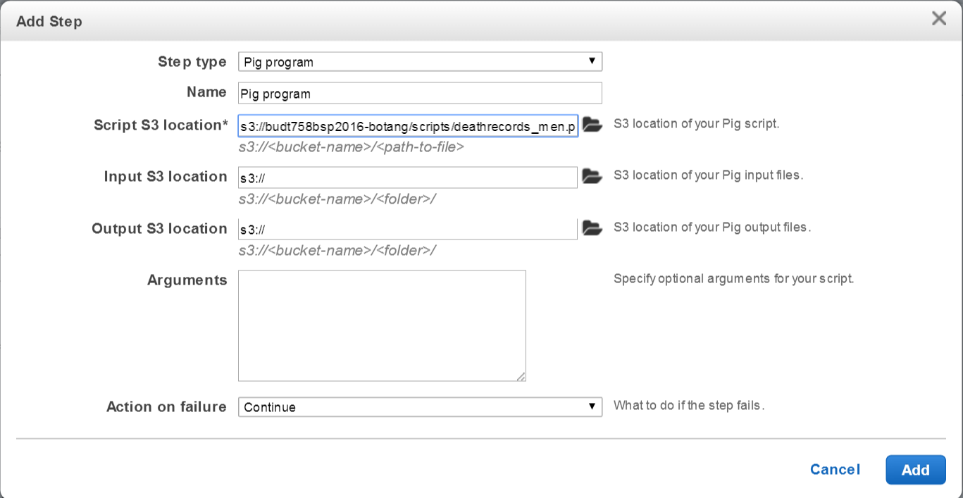
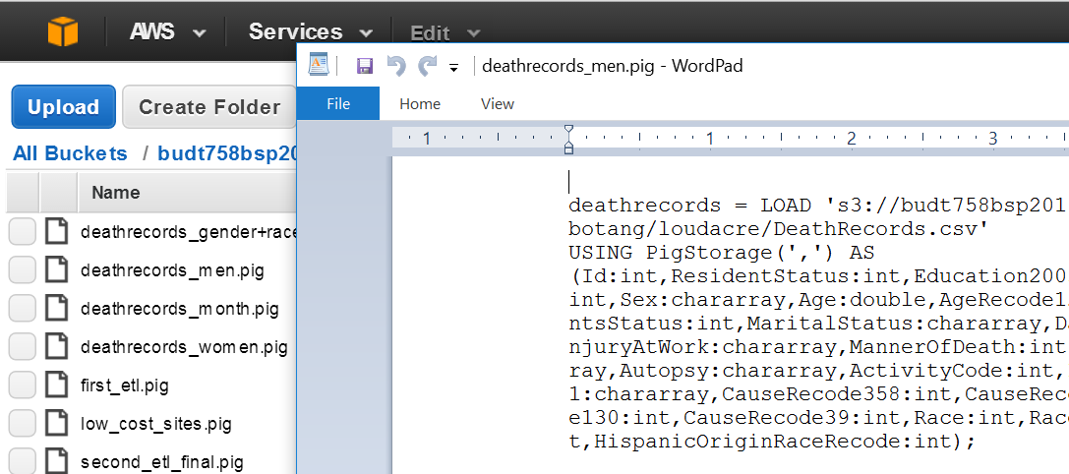
2
Data Processing
Pig/Hive + AWS/VM:
Results!
【Identify the question】
Create SQL queries according to the problem.
Run scripts on an AWS cluster
【Process the script】
Use SQL queries to create corresponding Pig scripts, then run Pig on an AWS cluster.
Create Pig scripts
PPT模板下载：www.1ppt.com/moban/ 行业PPT模板：www.1ppt.com/hangye/
节日PPT模板：www.1ppt.com/jieri/ PPT素材下载：www.1ppt.com/sucai/
PPT背景图片：www.1ppt.com/beijing/ PPT图表下载：www.1ppt.com/tubiao/
优秀PPT下载：www.1ppt.com/xiazai/ PPT教程： www.1ppt.com/powerpoint/
Word教程： www.1ppt.com/word/ Excel教程：www.1ppt.com/excel/
资料下载：www.1ppt.com/ziliao/ PPT课件下载：www.1ppt.com/kejian/
范文下载：www.1ppt.com/fanwen/ 试卷下载：www.1ppt.com/shiti/
教案下载：www.1ppt.com/jiaoan/ PPT论坛：www.1ppt.cn
Create SQL
queries
【Get the result】
Get the results and visualize the results.

Slide 6


2
Data Processing
Predict Model: PySpark + AWS:
Results!
Create python scripts
Login to the master node of SSH
Start PySpark
Run scripts in python terminal

Slide 7
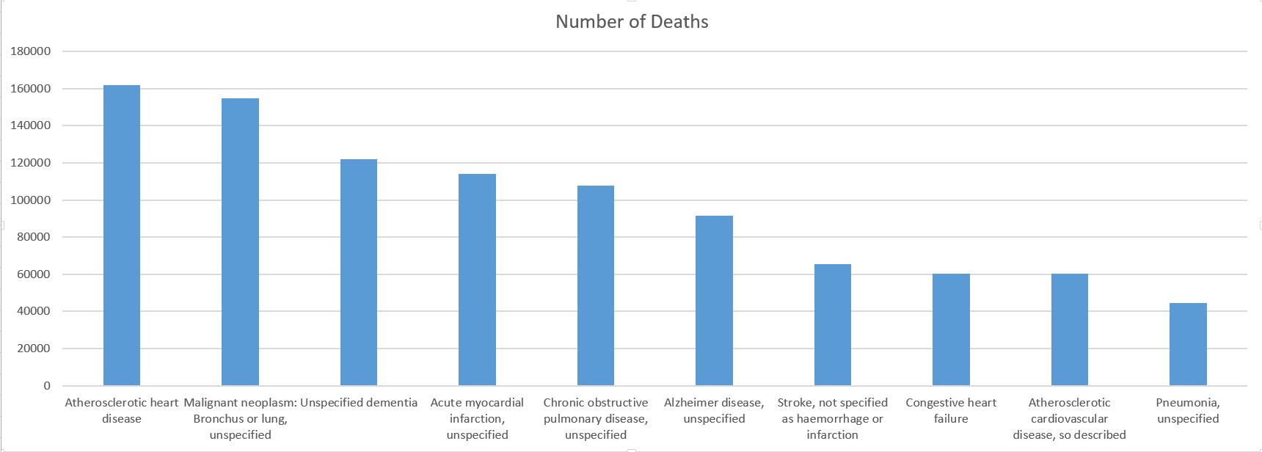
3
Results & Visualization
Systematic patterns to the health issues:

Slide 8
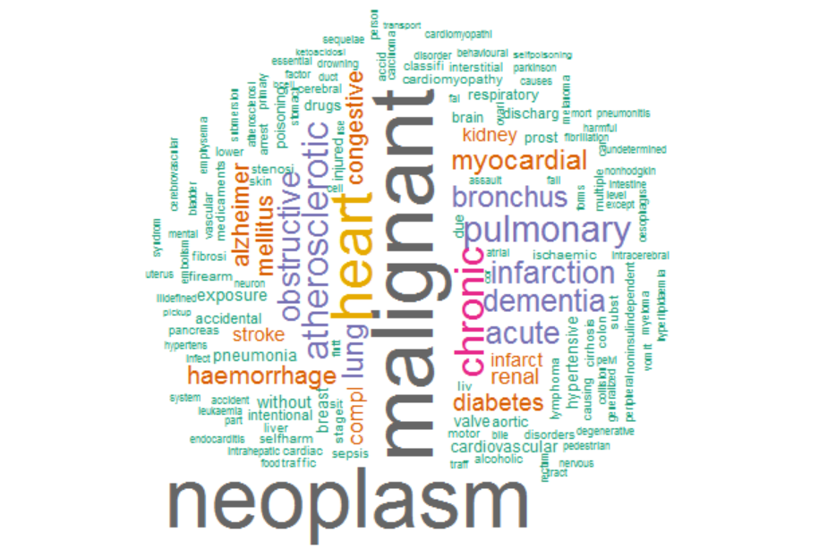
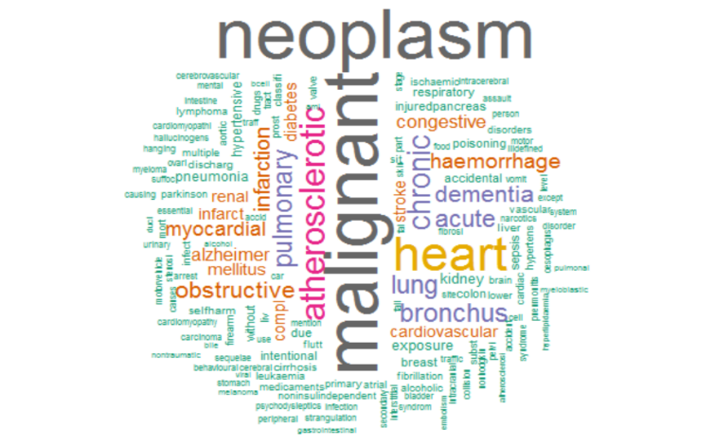
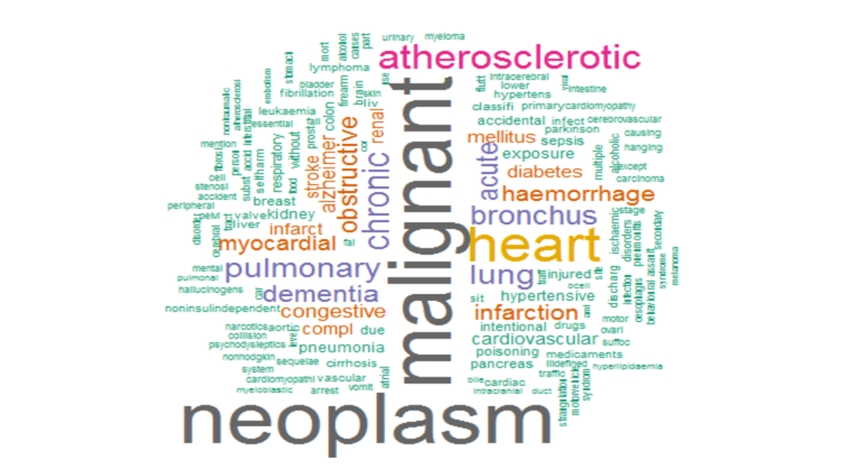
1,000 rows
3
Results & Visualization
200,000 rows
The whole dataset

Slide 9
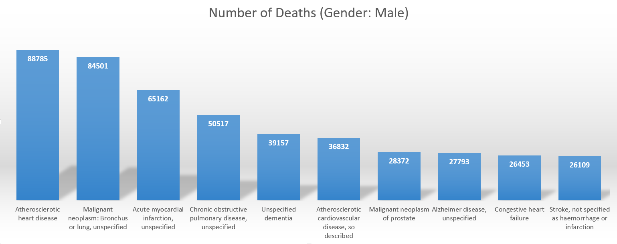
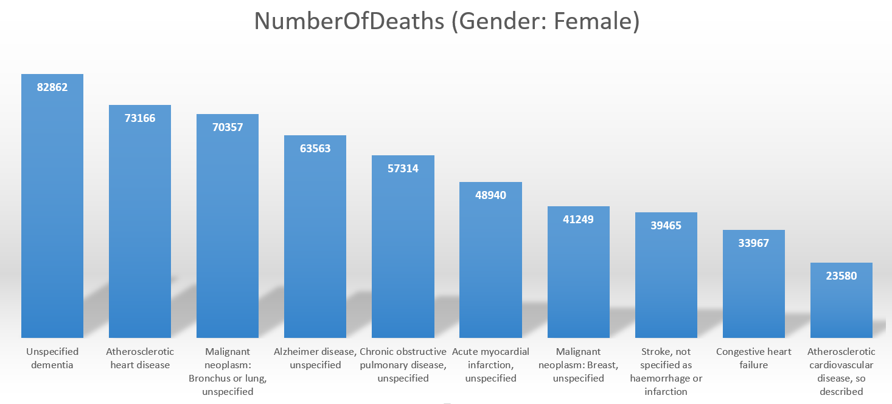
3
Results & Visualization
Patterns across Race, Gender and Education

Slide 10
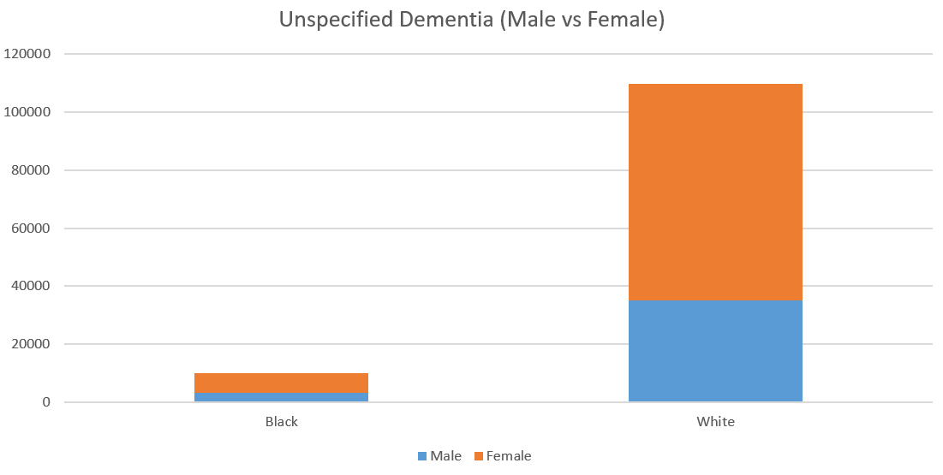
3
Results & Visualization
Patterns across Race, Gender and Education

Slide 11

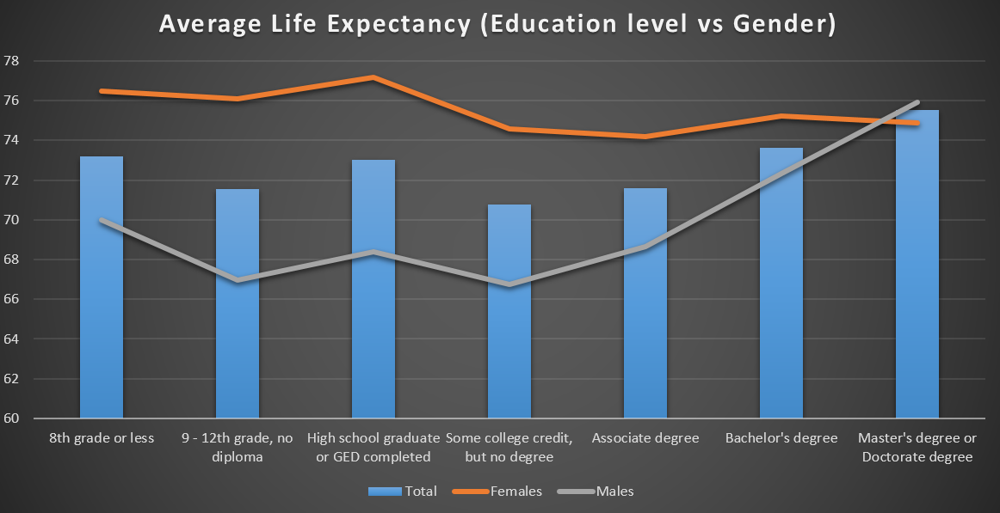
3
Results & Visualization
Patterns across Race, Gender and Education

Slide 12

3
Results & Visualization
Gun-related deaths
Across all the deaths about 1.263% of the deaths are due to gun related issues.
The percentage of autopsy is 67.5% in the gun related deaths compared to only 7.7% across all the deaths.
Blacks (Race) have a higher percentage of gun related deaths (2.47%) compared to White (1.108%).

Slide 13
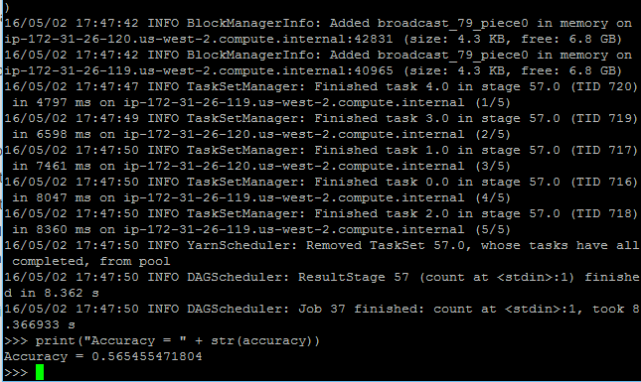
3
Results & Visualization
Prediction model: Cremation or Burial?
Naïve Bayes Model:
Accuracy = 56.5%

Slide 14
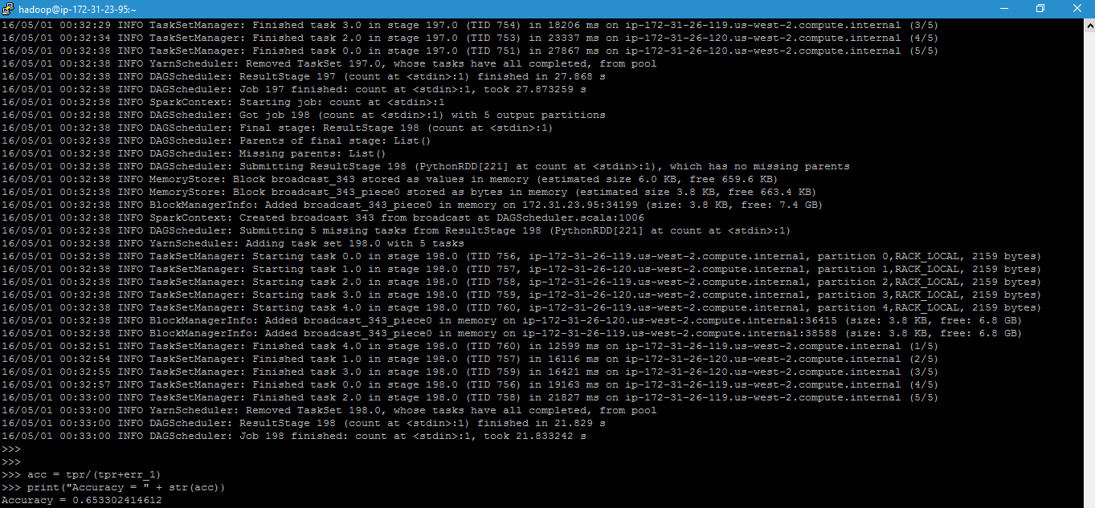
3
Results & Visualization
Prediction model: Cremation or Burial?
Logistic Regression Model:
Accuracy = 65.3%

Slide 15
4
Highlights & Policy Suggestions
Some interesting discovery:
!!!
(deceptive)

Slide 16

4
Highlights & Policy Suggestions
Suicide Rate
Policy Suggestion: Create support groups to target singles with
stress and depression

Slide 17
4
Highlights & Policy Suggestions
Distribution of deaths due to Alzheimer’s
Policy Suggestion: Make health policy decisions and allocate funds for
special diseases in a particular age group

Slide 18


The end
Thank you!

